Slide 1
25mm CZC
CZC
10mm BGO
BGO
16 x 16 Array of
3 x 3 mm SiPMs
@ 3.2 x 3.2 mm pitch
Light Mixer for DOI
and reflector

Slide 2
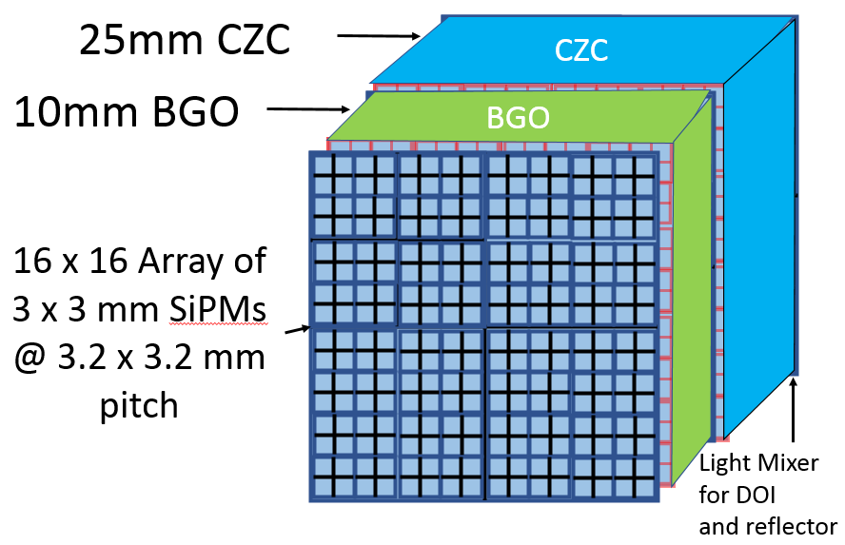

Slide 3
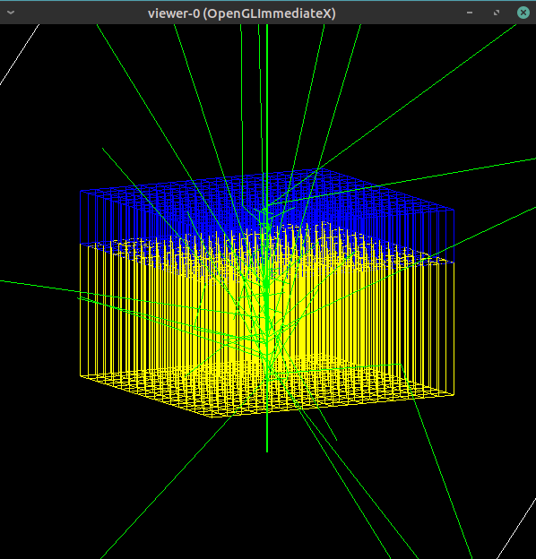
25mm CZC
10mm BGO
Incident from
Center of CZC
Side of block

Slide 4
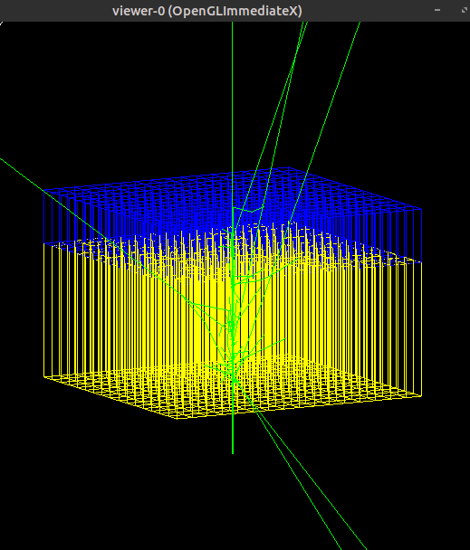
25mm LYSO
10mm BGO
Incident from
Center of LYSO
Side of block

Slide 5
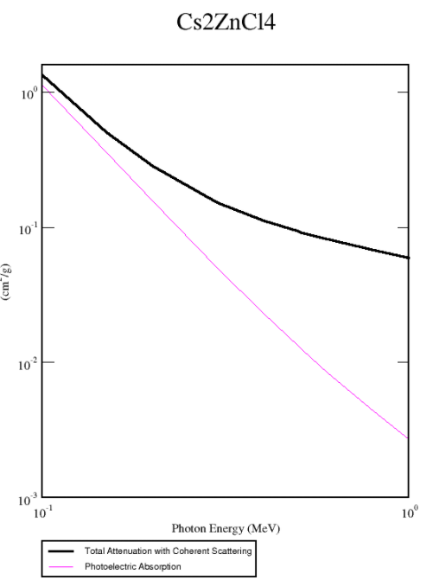
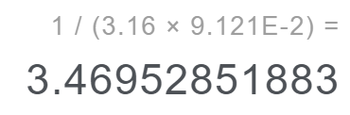

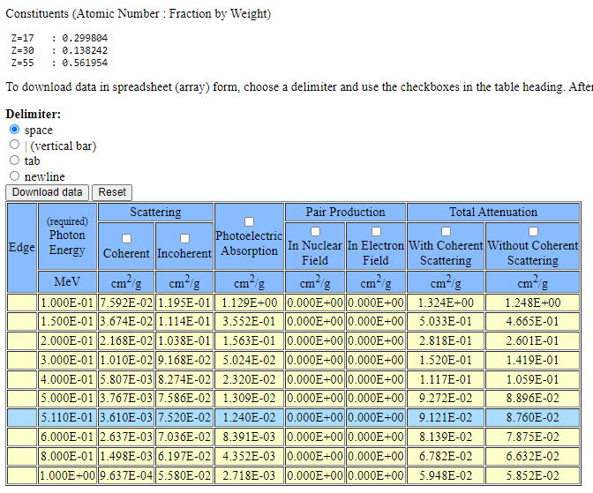
ρ = 3.16 g/cm^3 -> Attenuation Length cm. @ 511keV = 3.47 cm
Photocapture Fraction @ 511keV
= 14.2 %

Slide 6
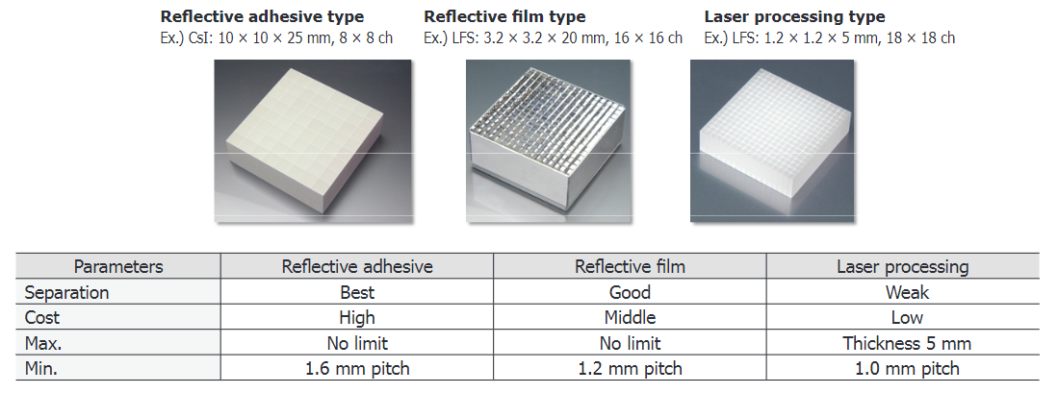
MPPC Module for PET Hamamatsu Technical Note
3.2 x 3.2 x L mm CZC, 16 x 16 array
3.2 x 3.2 x T mm BGO, 16 x 16 array
Reflective film or adhesive type
www.hamamatsu.com/resources/pdf/ssd/pet_module_kacc9009e.pdf

